Slide 1


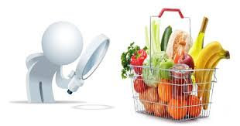
Market basket analysis
Presented by:
Rushiraj Savalia
Vishesh Shah
15th April 2020

Slide 2
Contents
Market Basket Analysis
Introduction
Objective
DATA description
Data visualization
PREDICTIVE MODEL AND PERFORMANCE
Model creation
Result and conclusion

Slide 3
Introduction
Large number of people use to visit shopping malls and grocery stores like Instacart, target, wholefood
Massive amount of data continuously being collected and stored As transactions of different customers
Those collected data can be useful from business perspective to analyze the pattern of how customers buy various products

Slide 4
Objective
TO ANALYZE THE PATTERN OF PURCHASEING OF CUSTOMERS (TYPE OF PRODUCT FREQUNETLY REORDERED)
TO FIND WHAT CAN BE THE NEXT ORDER FOR A CUSTOMER BY USING PREVIOUS AVAILABLE OF VARIOUS CUSTOMERS’ TRANSACTIONS
IT ASSIST TO MANAGE INVENTORY IN BETTER MANNER SO COMPONY CAN SAVE LOTS OF MONEY FROM THAT

Slide 5
DATA DESCRIPTION
Customer Transactions
Order id, User id
Product Information
Product id
Product name
Product location (Aisle and Department)
Order number of that particular user
Day of week and Hour of the day of each order
Day since previous order of that particular user
Items that reordered or not for each order

Slide 6
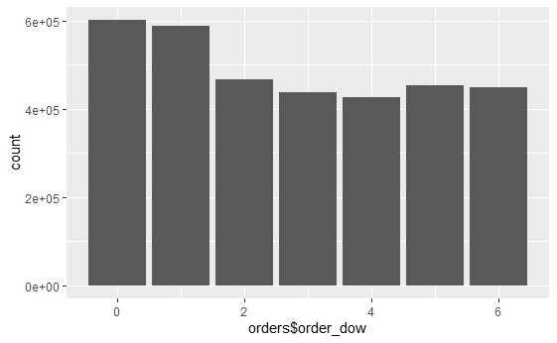
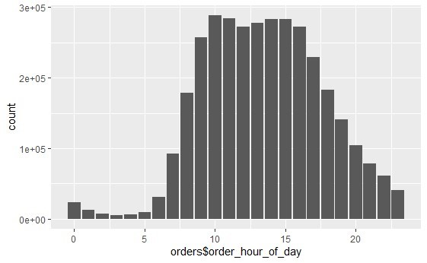
Data Visualization
Bar chart of count according to a day of week
Bar chart of count according to a hour of the day

Slide 7
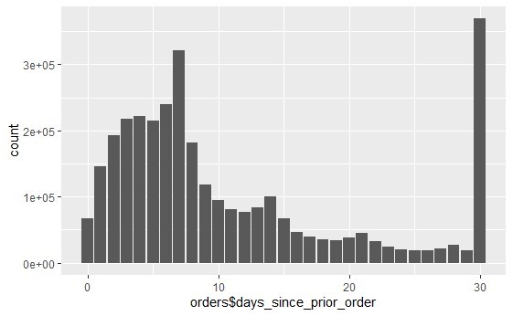
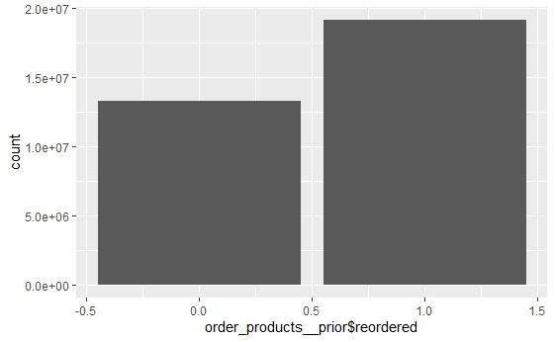
Bar chart of day since prior order
Box plot of the product reorder

Slide 8
Key insights form Various plots
USER usually buy more in starting of the week
Most of the orders are made between 8 AM to 4 PM.
USERS generally make orders on a weekly bases or monthly bases.
the chances of reordering are high

Slide 9
Data Processing
Data processing is the most important step in data mining as each predictive model has different requirement in terms of data input
Our first goal is to find that product will be reordered or not for that we use classification rule.
Predictors for that classification rule has been calculated by applying domain knowledge

Slide 10
List of Predictors and their formulas
Predictors from Product table
prod_orders: Total number of orders per product
prod_orders= prod_first_orders*prod_reorder_times
prod_reorder_times= 1+ (prod_reorders/prod_first_orders)
prod_reorder_probability: Probability a product is reordered after the first order
prod_reorder_probability= prod_second_orders/prod_first_orders
prod_reorder_times: How many times a product has been purchased by the users
prod_reorder_ratio: Reorders per total number of orders of the product

Slide 11
Predictors from Users table
user_orders: Total number of orders per user
user_period: The time between the first and last order of a user
user_mean_days_since_prior: Mean time between two consecutive orders of a single user
up_orders: The total times a user ordered a product
up_first_order: What was the first time a user purchased a product
up_last_order: What was the last time a user purchased a product
up_average_cart_position: The average position in a user's cart of a product
up_order_rate: Percentage of user’s orders that include a specific product
up_orders_since_last_order: Number of orders since user’s last order of a product
up_order_rate_since_first_order: Pecentage of orders since first order of a product in which a user purchased this product

Slide 12
Model Creation
Xgboost is used to predict binary variable called Product reordered or not
All categorical predictors converted to numerical using dummy variables as xgboost only accept numerical variables
Main reason to select Xgboost is it provides estimate of feature importance from given data so business analyst get to know which factor is more dominant

Slide 13
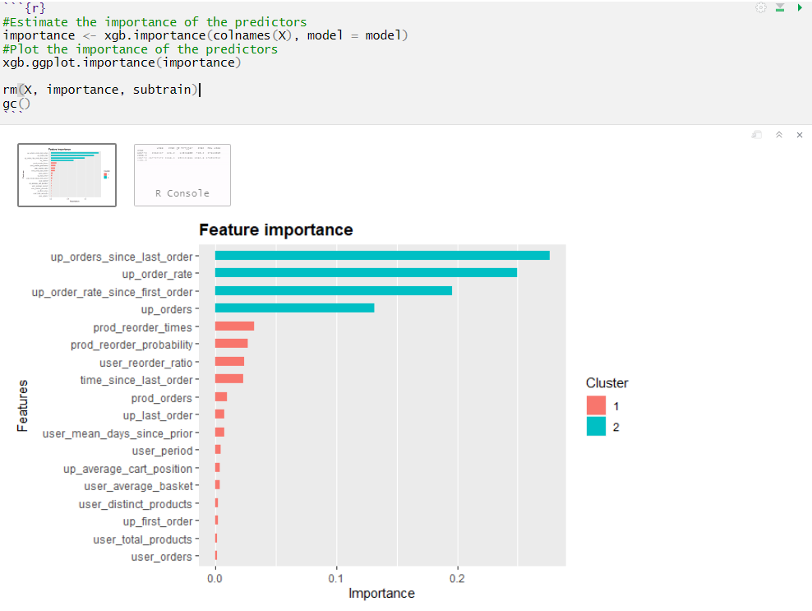
Result from the Xgboost showing feature importance

Slide 14
Future directions
Project results
We can see that when we apply the model to test and train data it shows order_id having that number can order the products as shown in second column.
Insights for decision making
Based on the list we got in both tables, Instacart can order those products in advance and save supply chain cost.
Impact of the project outcomes
We can submit these results to the officials of Instacart. Also, another benefit is that they can deliver all things while it’s fresh. That will surely make their customers happy and grow business.

